Slide 1

IKEA FURNITURE
TidytuesdaY DATASET 11/03/2020
Rachel Kean
Rachael Leonard
Marcie Matejka
Presentation date: 12/14/2020

Slide 2
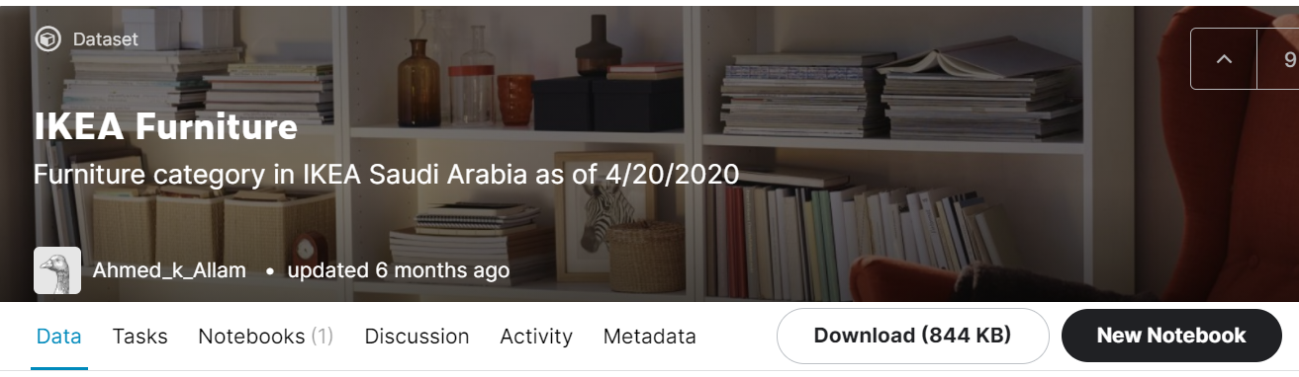
IKEA Furniture dataset from Kaggle

Slide 3
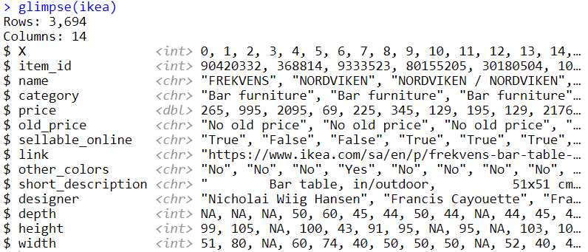
IKEA Data Glimpse

Slide 4
Questions?

Slide 5

Thank You
Rachel Kean
Rachael Leonard
Marcie Matejka

